Slide 1




What the Flux?
Using high frequency and spatially diverse data to improve flux estimation methods
Nicholas J Gubbins¹, Spencer Rhea², Weston M Slaughter², Mike Vlah², Amanda G DelVecchia², Matthew RV Ross¹, Emily S Bernhardt²
¹Colorado State University, ²Duke University

Slide 2
What is flux?
Flux = amount of material moving across a boundary over a given time
Flux = C×Q
Load = Flux integrated over time
Load = ∫C(t)Q(t)dt
Scaled to watershed size for comparisons
Sometimes referred to as ‘yield’
Valuable insight to watershed processes

Slide 3
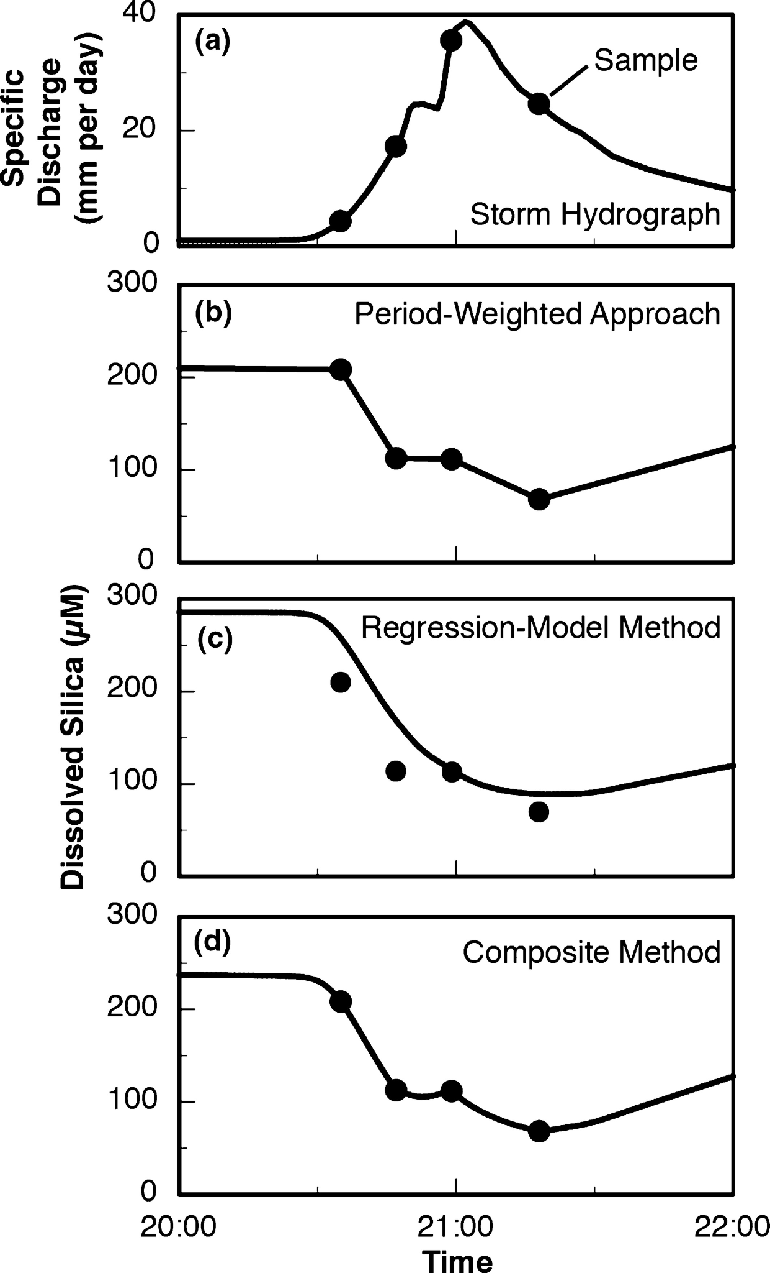
Challenges in calculating flux/loads
Discrete samples → discrete fluxes → continuous loads
Method overload!
Varying data frequencies
Validation (what is ‘true’?)
Intersite comparisons
From Aulenbach et al. 2016, originally published in Ecosphere as figure 1

Slide 4
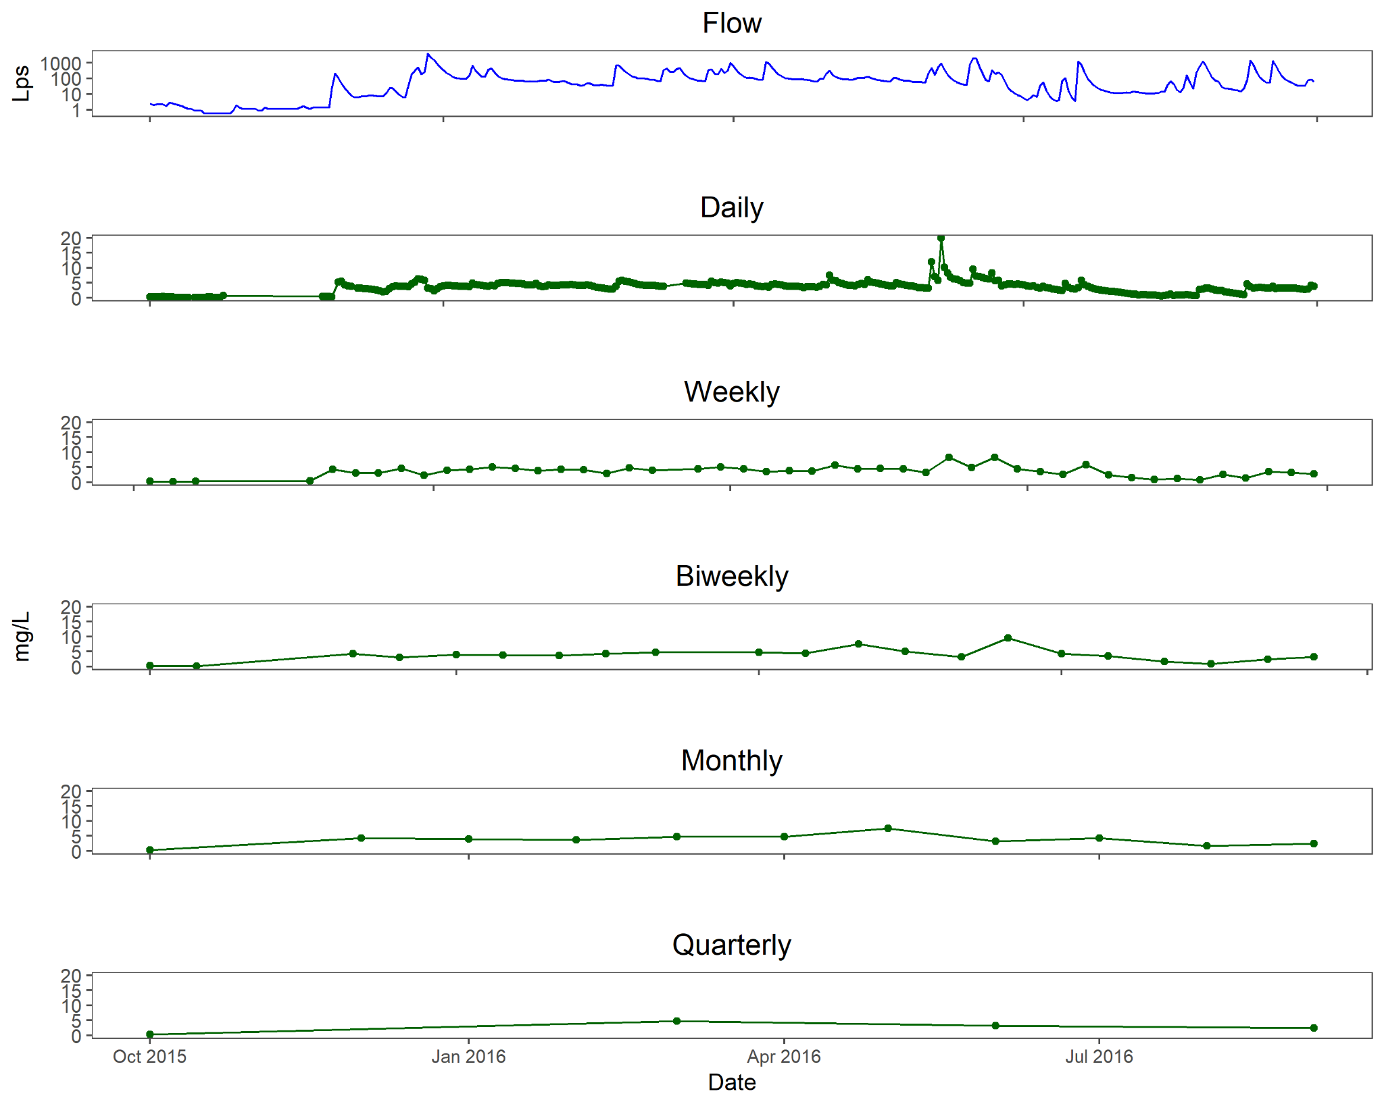
Data courtesy of USGS
Notes:
2016 WY at School Branch study site in Indiana (helped collect some of this Q). What samples you have determines what you know

Slide 5
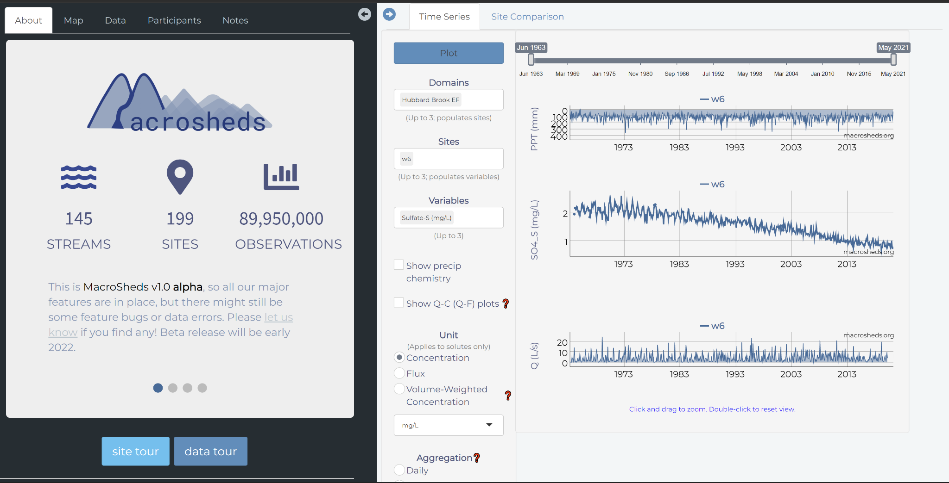
Notes:
Macrosheds is a project that seeks to harmonize NSF funded watershed studies and enable researchers to tackle continental scale watershed science questions

Slide 6
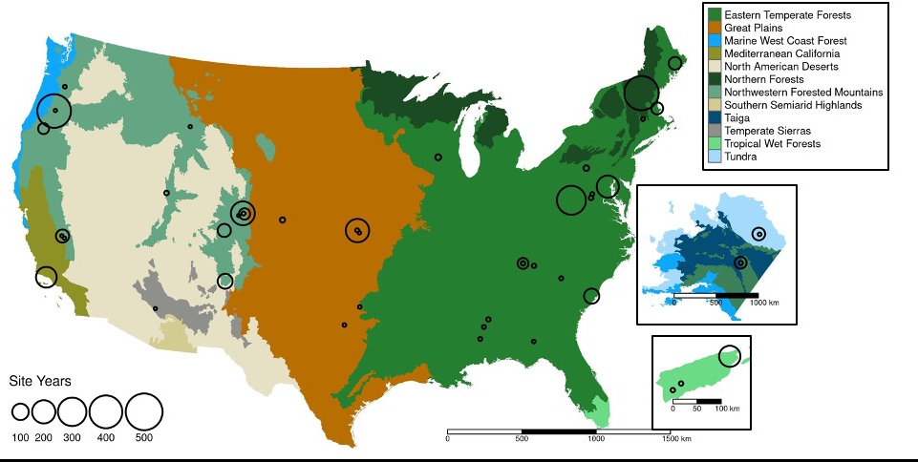
From Vlah et al. 2022 (in review). Check out our portal on macrosheds.org!
Notes:
The macrosheds dataset is spatially and ecologically diverse!

Slide 7
How should we calculate flux/loads for this diverse group of small watersheds?

Slide 8
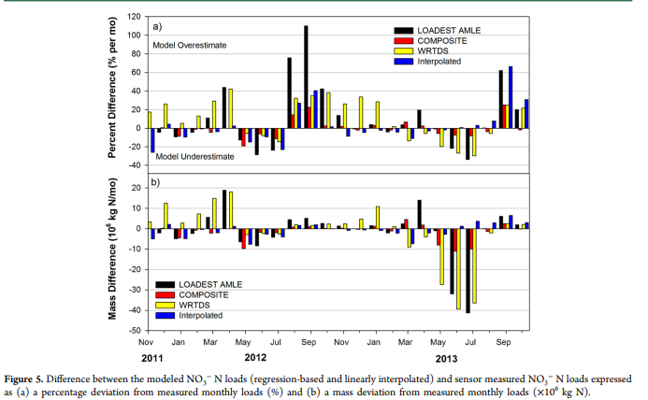
From Pellerin et al. 2014, originally published in Environmental Science & Technology
Notes:
Brain Pell-err-in looked at mississippi river nitrate. Used high frequency data as ‘truth’ and biweekly chem samples to calculate monthly loads via an array of methods. Found high and low flows dominated error.

Slide 9
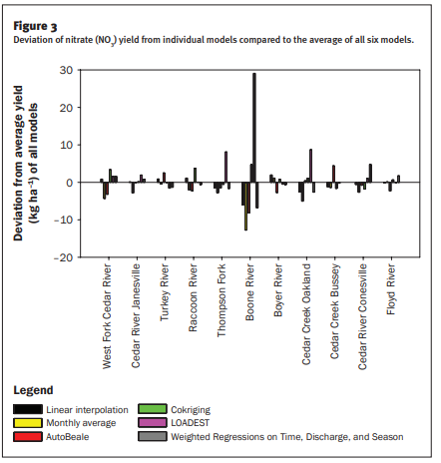
From Schilling et al. 2017, originally published in Journal of Soil and Water Conservation © 2017 by the Soil and Water Conservation Society
Notes:
Schilling et al looked at nitrate fluxes from 11 Iowa streams and generally found that methods did not agree with each other. Expressed need for better techniques.

Slide 10
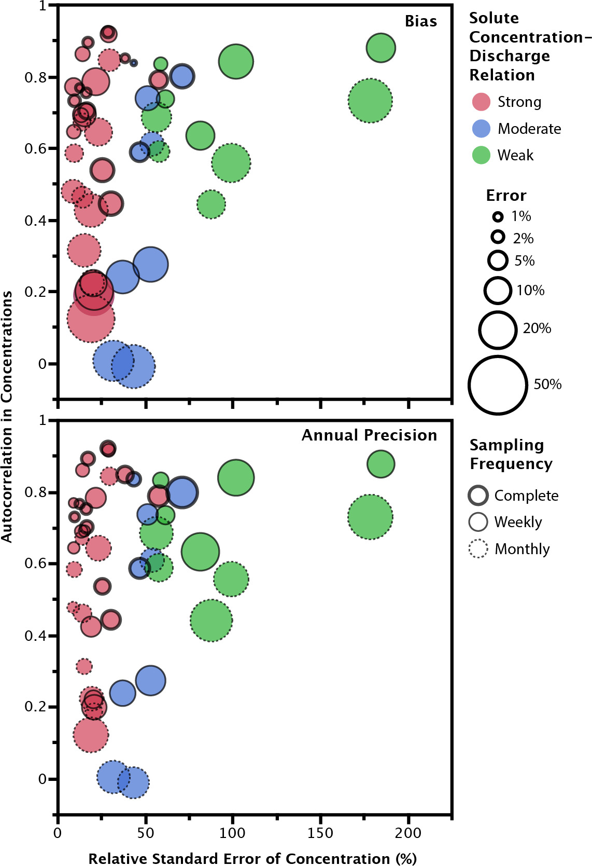
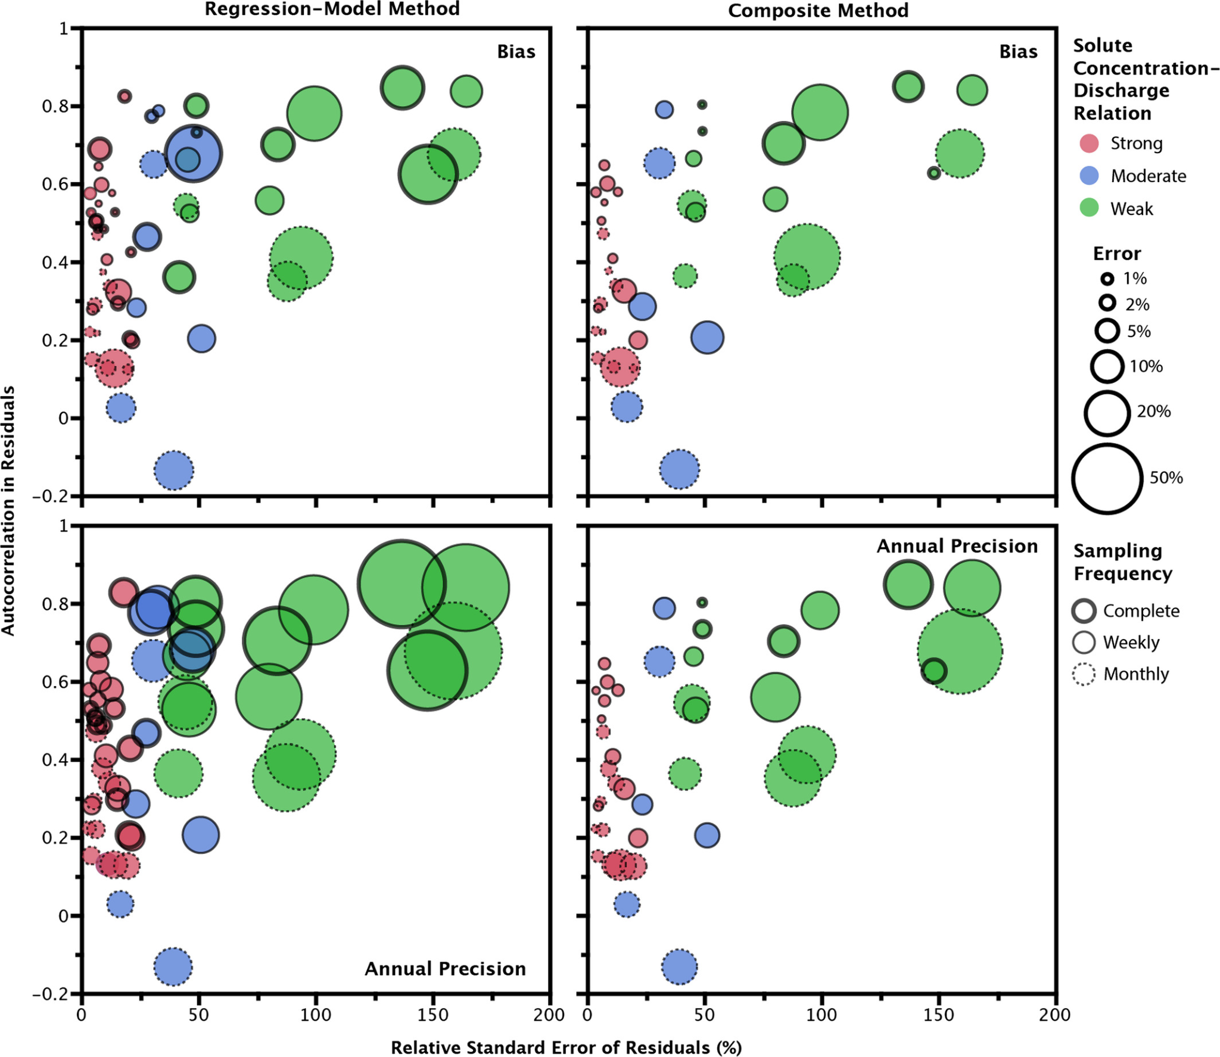
From Aulenbach et al. 2016, originally published in Ecosphere as figures 8 and 9
Notes:
Found error tracked well with C:Q relationship, sampling frequency, and autocorrelation of residuals

Slide 11
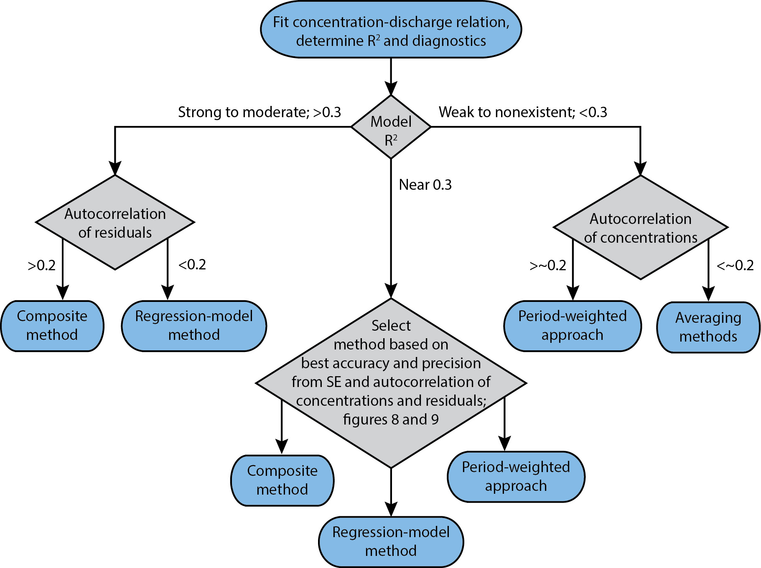
From Aulenbach et al. 2016, originally published in Ecosphere as figure 10
Notes:
Created flowchart of recommendations for load calculation based on model parameters

Slide 12

Our analysis
USGS data requirements
15 minute data for nitrate and discharge
No more than 15% missing data
Watershed size <1000 km
MS data requirements
At least daily nitrate and discharge
No more than 15% missing data
Calculate ‘truth’ with high frequency data and composite method
Coarsen chemistry data by pulling single values from full dataset
Apply methods to each coarsened time series and compare
Period-weighted (via RiverLoad R package)
Beale Ratio (via RiverLoad R package)
Rating (as described in Aulenbach et al. 2016)
Composite (as described in Aulenbach et al. 2016)
Notes:
Beale :ratio of load to flow for the entire year should equal ratio on dates where concentration was measured

Slide 13
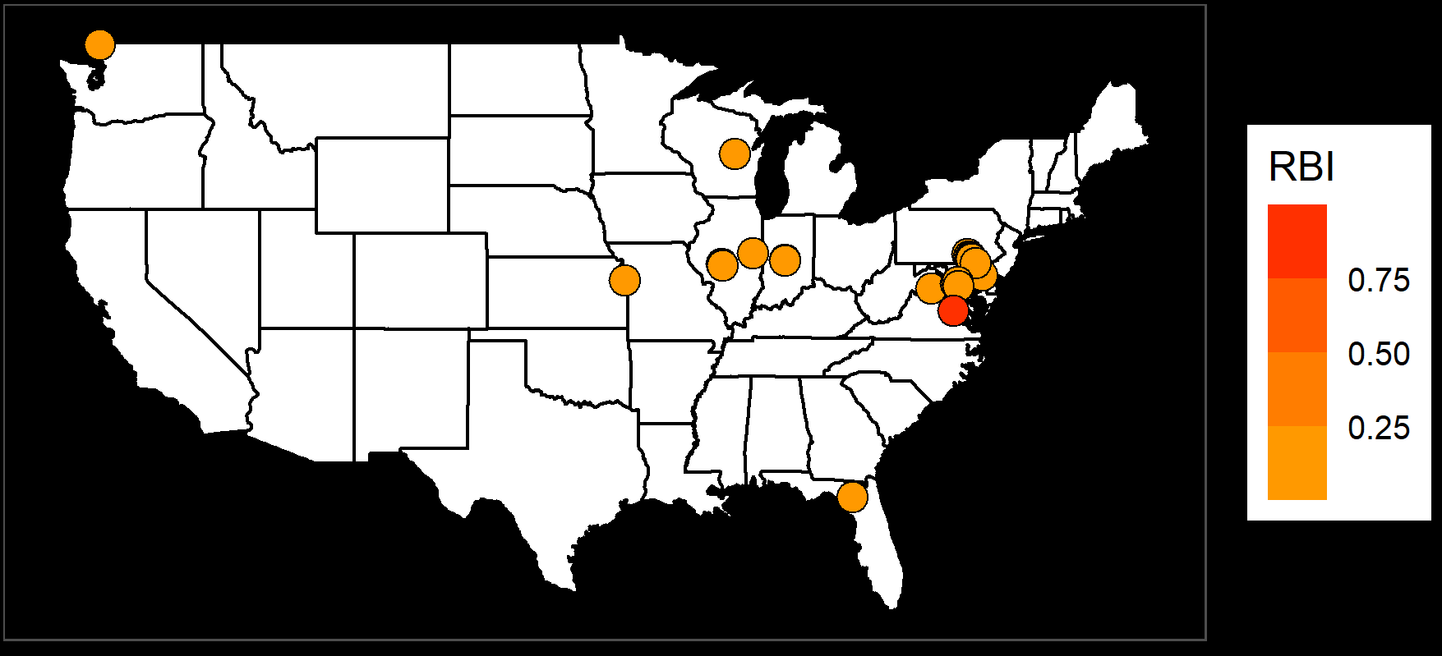
USGS sites used in analysis

Slide 14
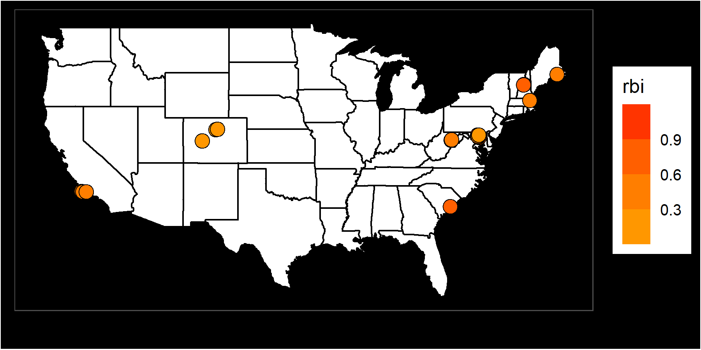
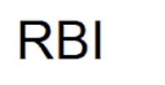
Macrosheds sites used in analysis

Slide 15
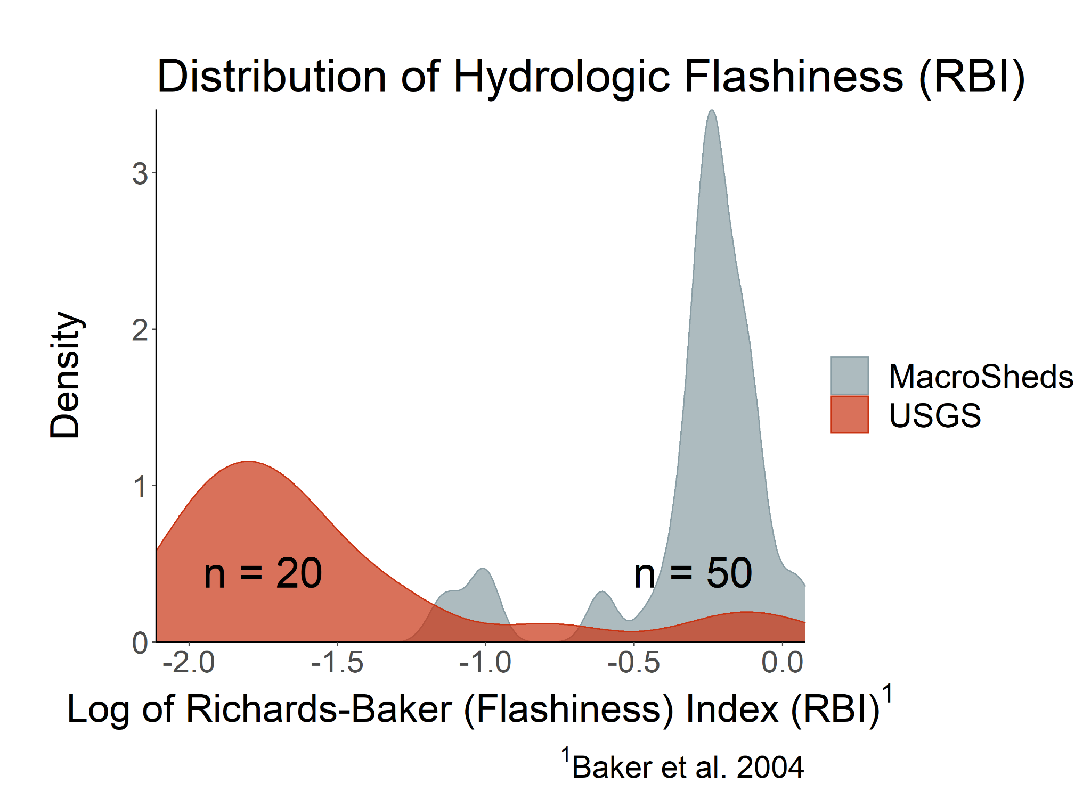
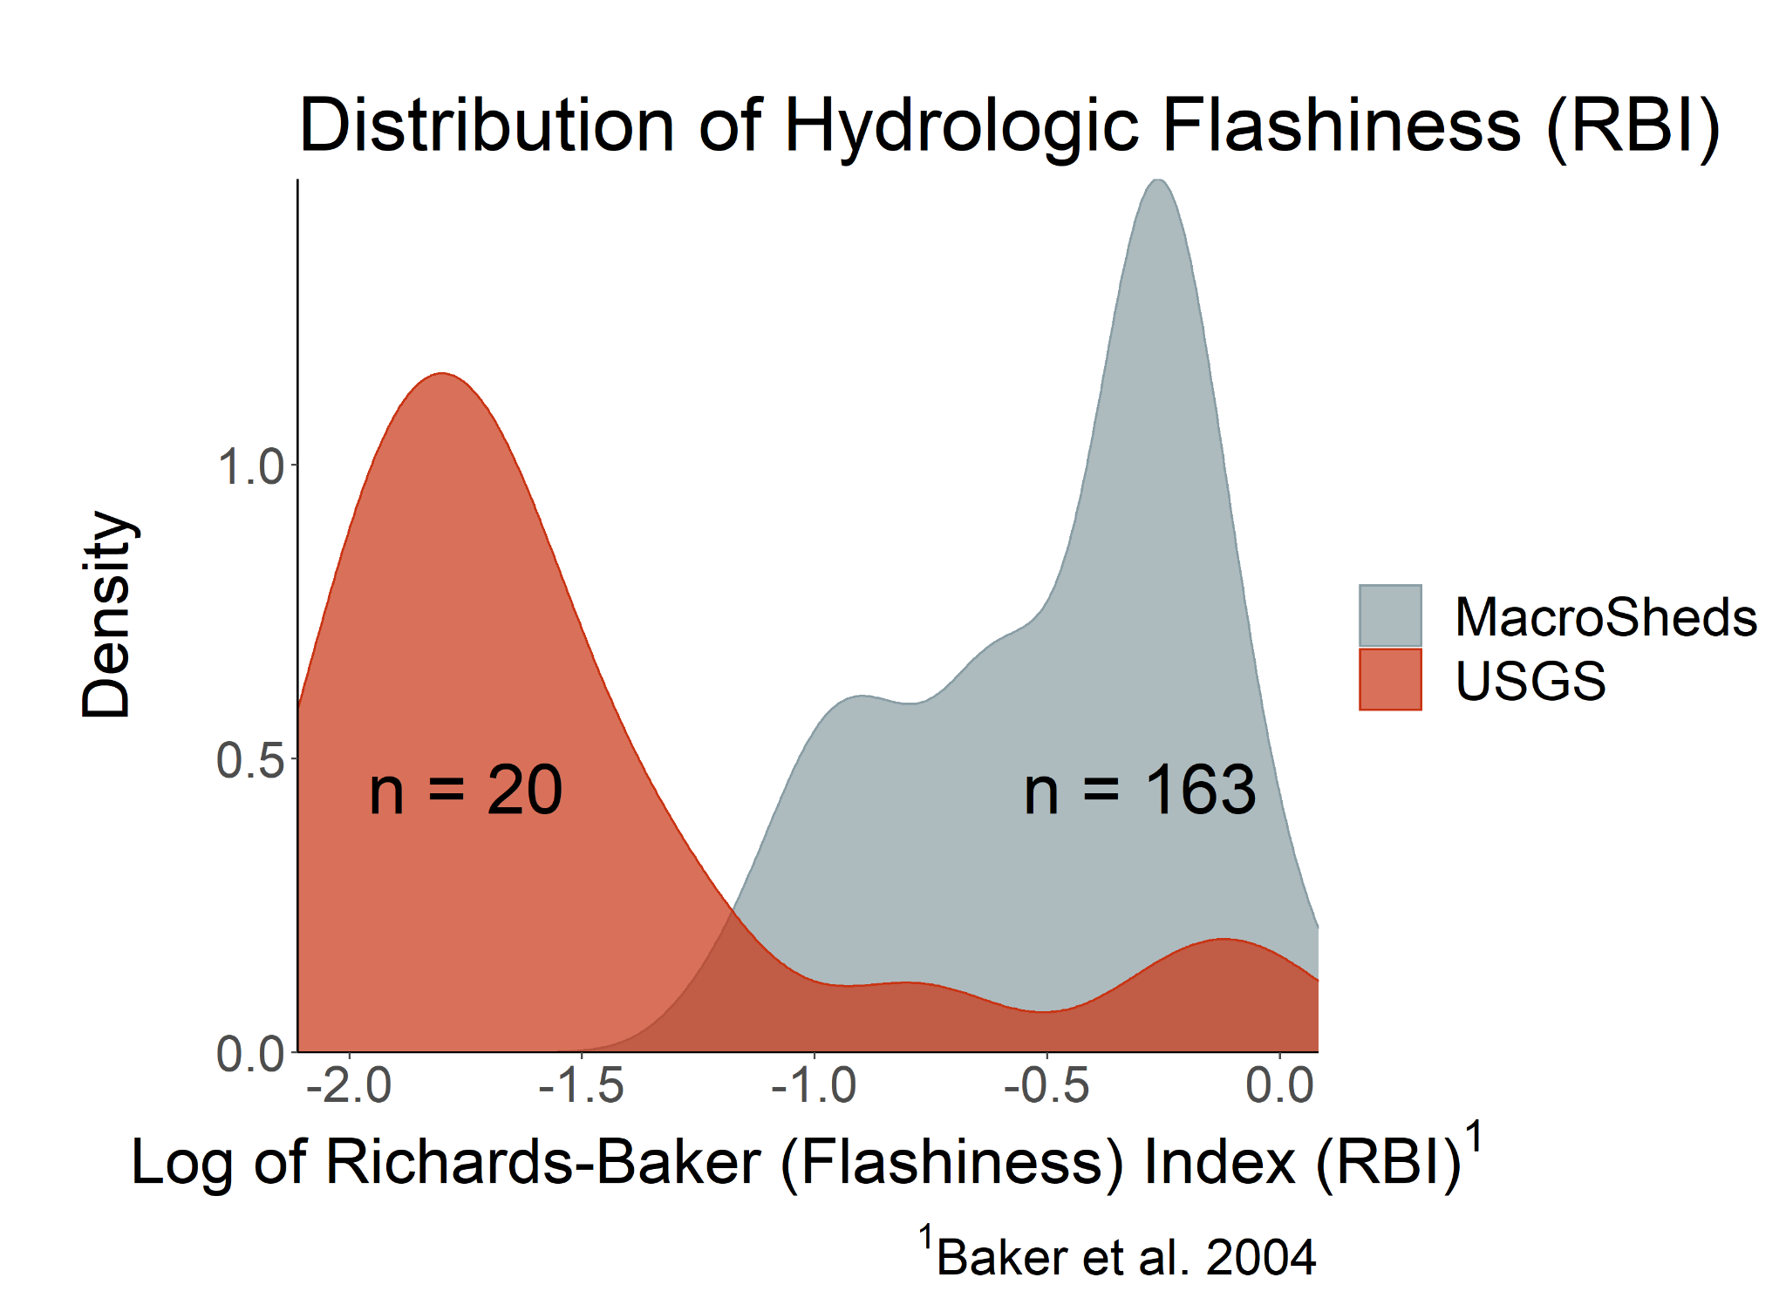

Slide 16
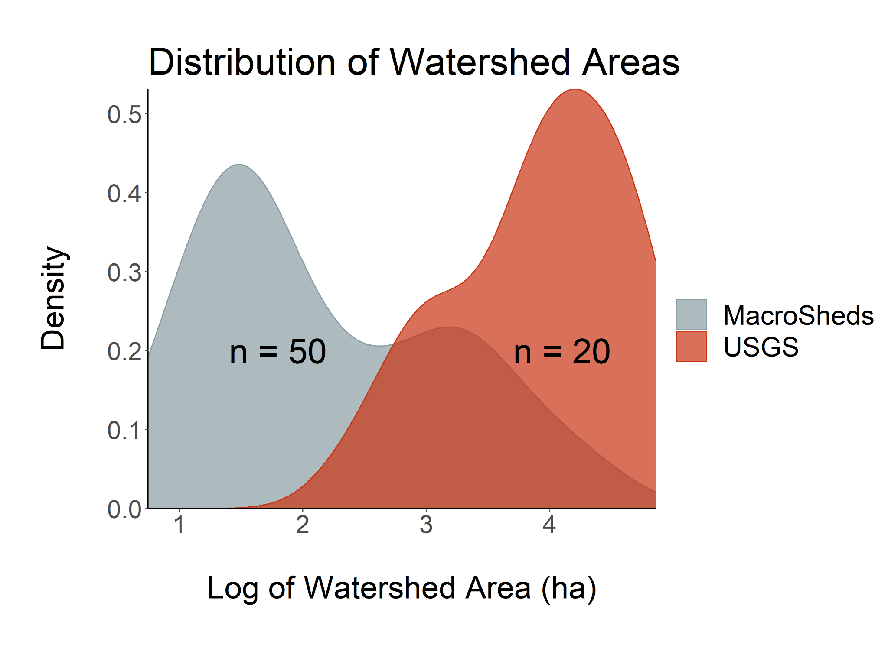
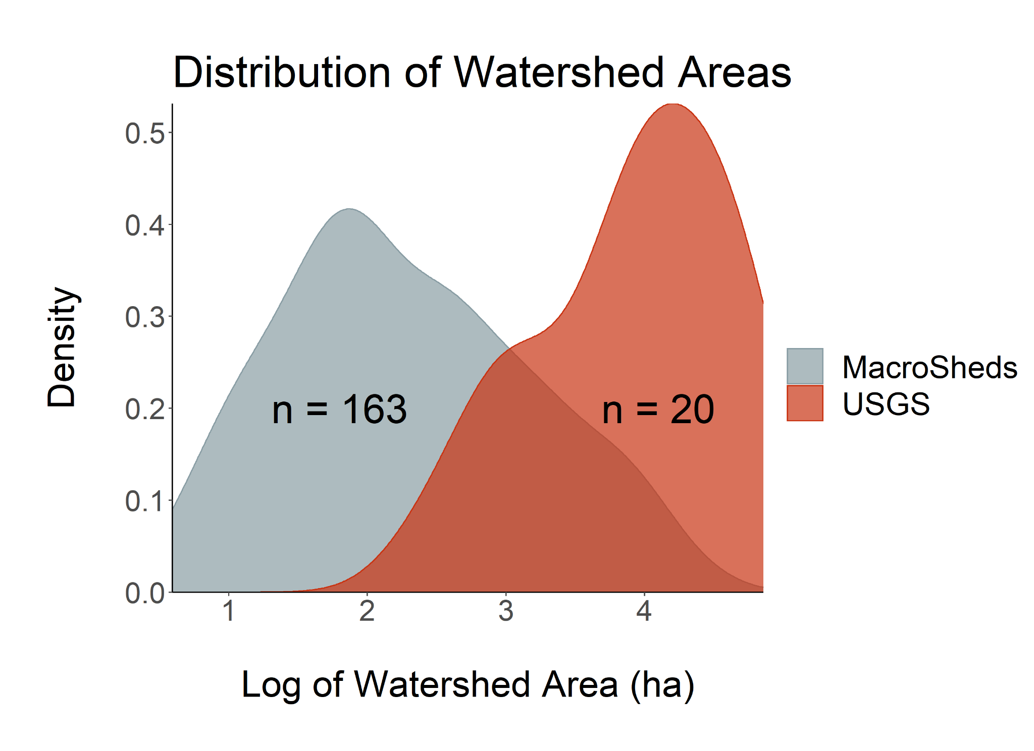

Slide 17
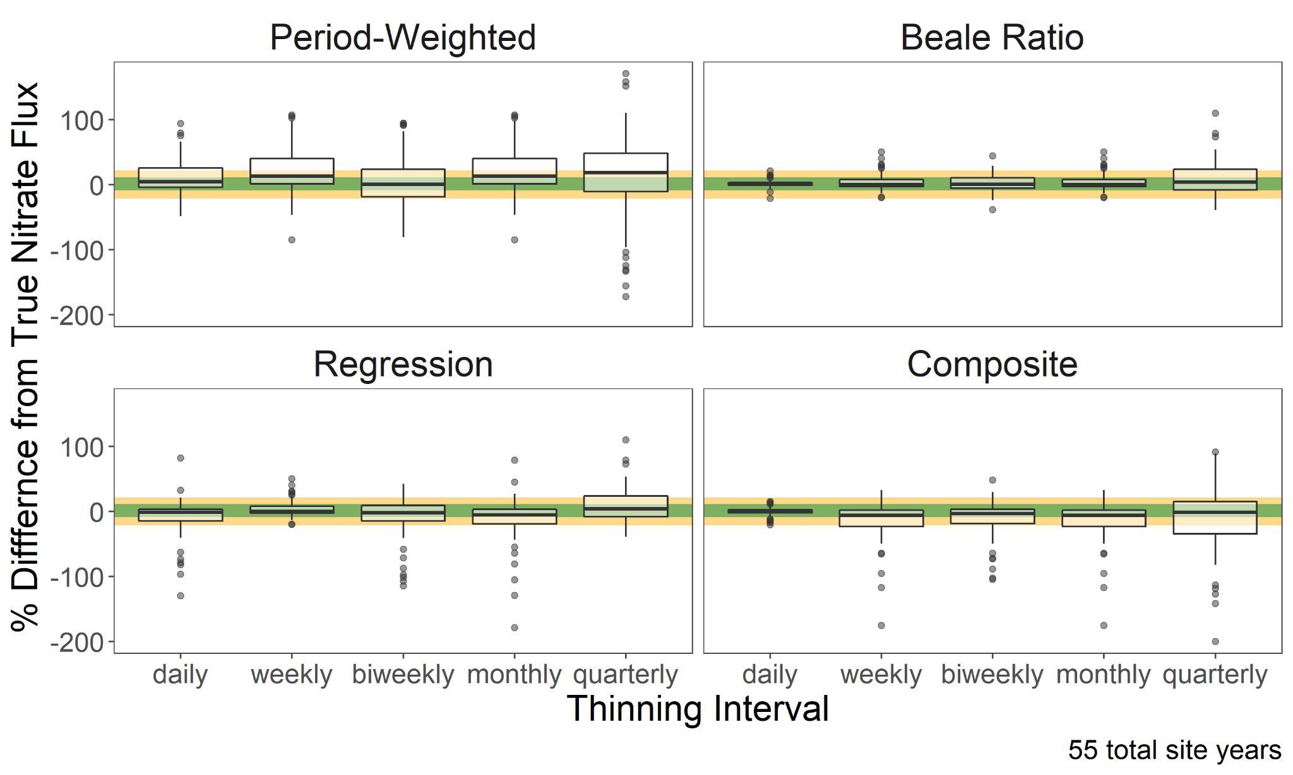
Results: USGS
Notes:
Green is 10+/-, yellow 20 +/- (based on Aulenbach et al 2016)

Slide 18
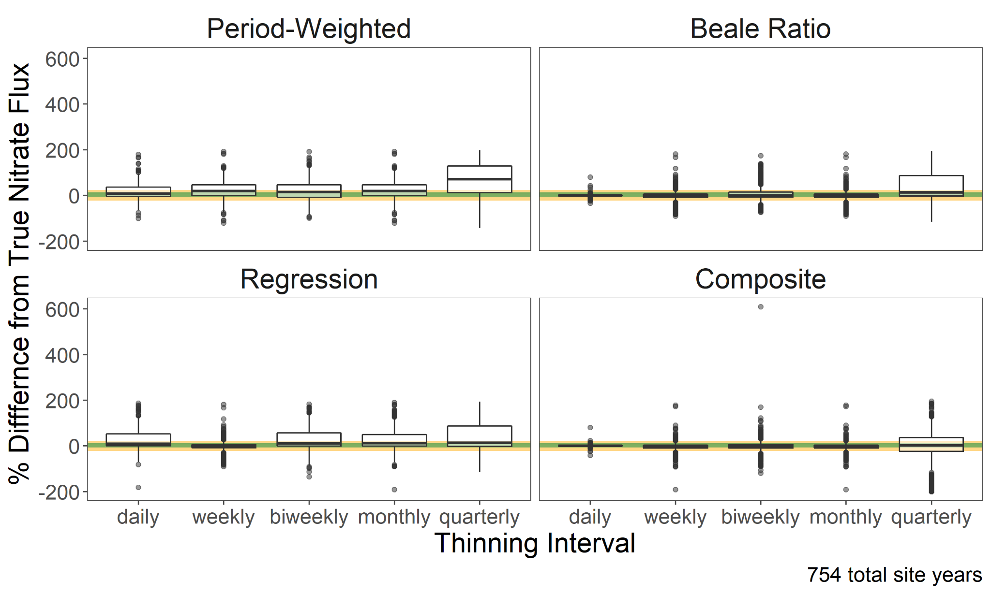
Results: Macrosheds

Slide 19
How should we calculate flux/loads for this diverse group of small watersheds?

Slide 20
Key takeaways
Answer: we don’t really know
Flashier systems yield greater load uncertainty
Simple methods cannot accurately describe nitrate flux in small watersheds
But Beale Ratio was surprising robust in both USGS and MS test cases
Current high-quality, public datasets bias big and stable (for good reasons!)
Looking at only the smallest USGS sites would give false confidence
We need for more high-frequency C and Q data from small watersheds

Slide 21
Moving forward…
More methods (e.g. WRTDS) and more solutes
C:Q changepoint analysis
Evaluate monthly load estimation
Robust, but simple decision pipeline for macrosheds dataset
Similar to (if not exactly) Aulenbach et al 2016
More fluxes/loads publicly available soon on macrosheds.org!

Slide 22
Works Cited
Aulenbach, B. T., Burns, D. A., Shanley, J. B., Yanai, R. D., Bae, K., Wild, A. D., Yang, Y., and Yi, D.. 2016. Approaches to stream solute load estimation for solutes with varying dynamics from five diverse small watersheds. Ecosphere 7( 6): e01298. 10.1002/ecs2.1298
Baker, D.B., R.P. Richards, T.T. Loftus, and J.W. Kramer. 2004. A New Flashiness Index: Characteristics and Applications to Midwestern Rivers and Streams. April 2004. Journal of the American Water Resources Association (JAWRA). Pages 503:522.
Likens, Gene E, Biogeochemistry, the watershed approach: some uses and limitations. Marine and Freshwater Research 2001, 52, 5-12.
Nava V, Patelli M, Rotiroti M, Leoni B . “An R package for estimating river compound load using different methods.” Environmental Modelling and Software 2019, 117, 100-108. https://doi.org/10.1016/j.envsoft.2019.03.012.
Brian A. Pellerin, Brian A. Bergamaschi, Robert J. Gilliom, Charles G. Crawford, JohnFranco Saraceno, C. Paul Frederick, Bryan D. Downing, and Jennifer C. Murphy; Environmental Science & Technology 2014 48 (21), 12612-12619; DOI: 10.1021/es504029c
K.E. Schilling, C.S. Jones, C.F. Wolter, X. Liang, Y.-K. Zhang, A. Seeman, T. Isenhart, D. Schnoebelen, M. Skopec, Variability of nitrate-nitrogen load estimation results will make quantifying load reduction strategies difficult in Iowa. Journal of Soil and Water Conservation Jul 2017, 72 (4) 317-325; DOI: 10.2489/jswc.72.4.317
Special thanks to MS team members Audrey Thellman and Nick Marzoff for talk feedback

